Slide 1
THT BOOTCAMP DABI BATCH 22 DIBIMBING.ID
Data-Driven Analysis of the Impact of Weather & Traffic Conditions on Food Delivery Time
Statistical analysis for a more realistic delivery time estimates
Ghairandi Al Abrar

Slide 2
PROJECT BACKGROUND
Business Problems
The estimated delivery time shown to customers is generally the same under all conditions, even though weather and traffic conditions in the field can vary considerably. This project uses historical data to determine which factors actually have an impact, rather than relying on assumptions.
1
ETA is not adaptive to actual conditions
2
Facts are not yet clear
Estimated time has not yet been adjusted for actual weather and traffic conditions
The operational factors that truly have an impact have not yet been definitively identified.
3
The impact of onfield conditions has not yet quantified
4
Risk of an increase in complaints received from customers
There has not yet been a quantification of the combined impact of adverse conditions.
The gap between expectations and reality might cause complaints from customers
2

Slide 3
DATA
Dataset Used
1.000
9
4
11,7%
Total order
Total column
Total missing columns
Affected rows
Columns in the dataset
Order_ID, Distance_km, Preparation_Time_min
Weather, Traffic_Level, Time_of_Day
Vehicle_Type, Courier_Experience_yrs
Delivery_Time_min (target)
Analysis target: explaining variations in Delivery_Time_min using a combination of operational factors (weather, traffic, etc) and distance/preparation factors, followed by a statistical significance test.
3

Slide 4
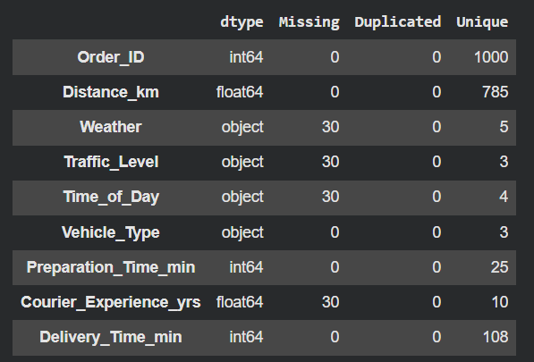
DATA
Data Cleaning
The missing data are randomly scattered across 117 rows (rather than concentrated in one place), and only 3 rows have missing values in more than one column.
Deleting them would mean discarding 11.7% of still-useful data, so imputation was chosen as the safer approach to preserve the sample size for subsequent statistical tests.
Why not just delete it?
Imputation Strategy
Categorical: Weather, Traffic_Level, Time_of_Day → handled with mode
Numerical: Courier_Experience_yrs → handled with median
Missing Value Pattern
117 unique rows affected out of a total of 1,000 (11.7%)
114 rows are blank in only 1 column
Only 3 rows are blank in more than 1 column
4

Slide 5
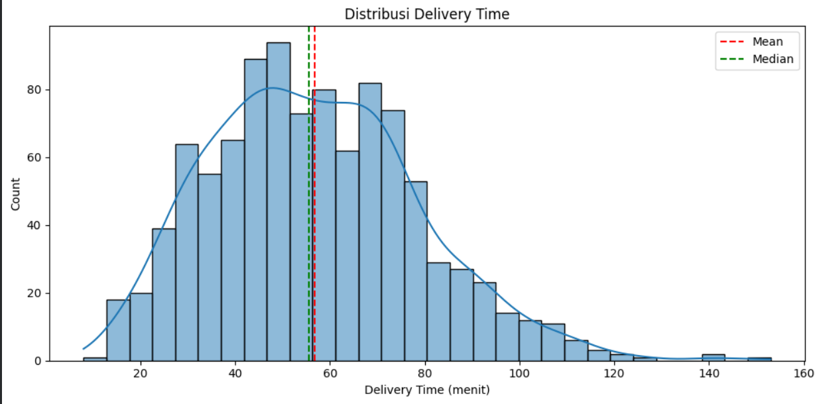
DATA EXPLORATION
Distribution of the Delivery Time Data
56,7
Average (minutes)
55,5
Median (minutes)
0,51
Skewness (right-skewed), a small number of orders took much longer than average
5

Slide 6
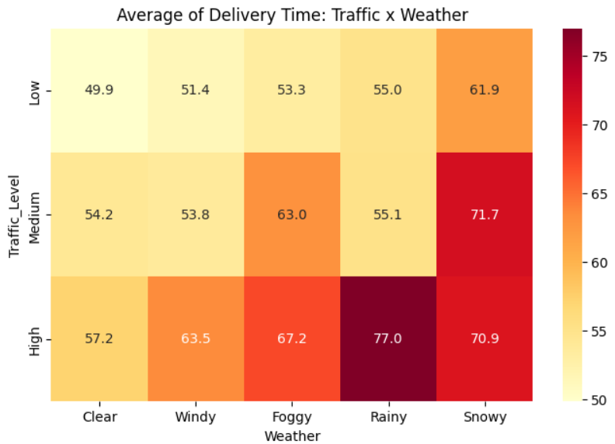
DATA EXPLORATION
Weather & Traffic Slow Down Deliveries
Snowy weather affects delivery time the most
Snowy weather conditions consistently have the longest delivery times, with the longest delivery occurring during rainy weather and heavy traffic conditions,
6

Slide 7
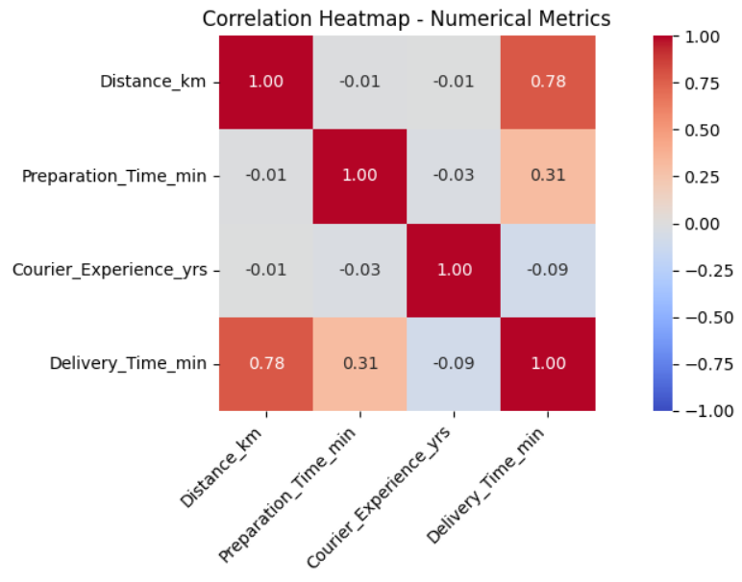
DATA EXPLORATION
Correlation Between Numerical Metrics
Distance is the dominant predictor of order delivery time
This is followed by the order preparation time at the restaurant/eatery itself, which has a moderate effect (r = 0.31). The courier’s experience has virtually no effect, with a correlation level of only (r = −0.09). These three predictors are also not correlated with one another, so the interpretation of each one’s effect on delivery time can be considered independent.
6

Slide 8
DATA EXPLORATION
Combination of Poor Conditions = Worst Delay
Best Condition
Worst Condition
49,9
77
+54%
minutes
minutes
slower
Low Traffic + Clear Weather
High Traffic + Rainy Weather
Interaction effects: The combined impact of high traffic and rain is worse than if the two effects were simply added separately (simple estimate: ~68 minutes; actual: 77 minutes). Snowy weather, meanwhile, remains consistently severe at all traffic levels (average: 68.2 minutes), whereas Rainy weather only rises sharply when traffic is high. Travel distance remains strongly correlated (r = 0.78) across all conditions.
7

Slide 9
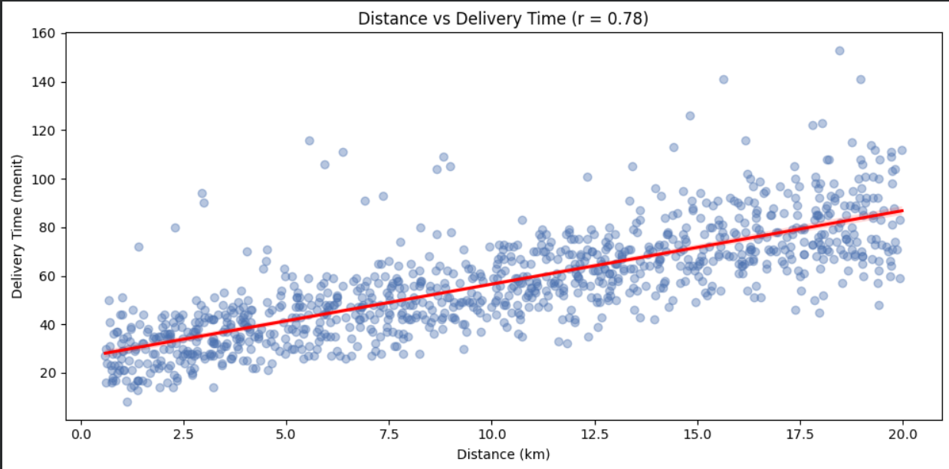
DATA EXPLORATION
Relationship Between Distance and Delivery Time
r = 0,78
Strong correlation between distance and delivery time
The greater the distance travelled, the longer the delivery time; this pattern is consistent across all weather and traffic conditions.
8

Slide 10
METHODS
From Visual Patterns to Statistical Evidence
1
2
3
4
Normality Check
Kruskal-Wallis
Effect Size
Insight
Shapiro-Wilk
H-test
Epsilon-squared
& Recommendations
p = 0,0000409
p < 0,00001
ε² = 3,3% & 3,5%
4 Business
Not normal
Significant
Small impact on delivery time
recommendations
9

Slide 11
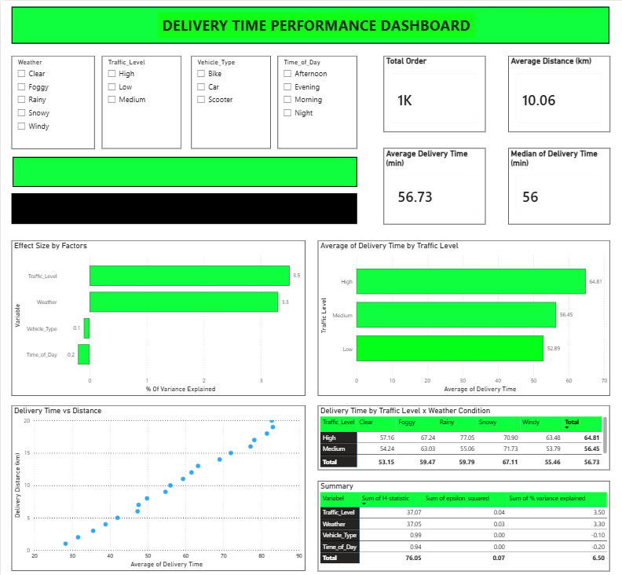
Insight
4 rekomendasi
9

Slide 12
RESULTS
Kruskal–Wallis Test Results
Testing whether the average delivery-time ranks differ significantly between groups for each categorical variable (α = 0.05).
Variable | Number of Groups (k) | H-statistic | p-value | Result
Weather | 5 | 37,05 | < 0,00001 | Significant
Traffic_Level | 3 | 37,07 | < 0,00001 | Significant
Vehicle_Type | 3 | 0,99 | 0,611 | Not significant
Time_of_Day | 4 | 0,94 | 0,816 | Not significant
Conclusion: Only Weather and Traffic_Level have been shown to have a significant effect on delivery time. There is insufficient evidence to conclude that Vehicle_Type and Time_of_Day have an effect.
10

Slide 13
RESULTS
Effect Size: Just How Powerful Its Effect on Delivery Time?
The p-value only indicates whether an effect exists. The effect size (epsilon-squared) indicates how substantial that effect is on the variable being analysed, calculated from the preceding Kruskal–Wallis results.
Scales of Interpretation
ε² = (H − k + 1) / (n − k)
< 0,01
Very Weak
0,01 – 0,08
Weak
Variables | ε² | % variance | Interpretation
Traffic_Level | 0,0352 | 3,5% | Weak
Weather | 0,0332 | 3,3% | Weak
Vehicle_Type | ≈ 0 | ≈ 0% | Very Weak
Time_of_Day | ≈ 0 | ≈ 0% | Very Weak
0,08 – 0,26
Medium
> 0,26
Powerful
Traffic_Level and Weather are statistically significant, but their magnitude falls into the small category. A real signal, not a dominant factor.
11

Slide 14
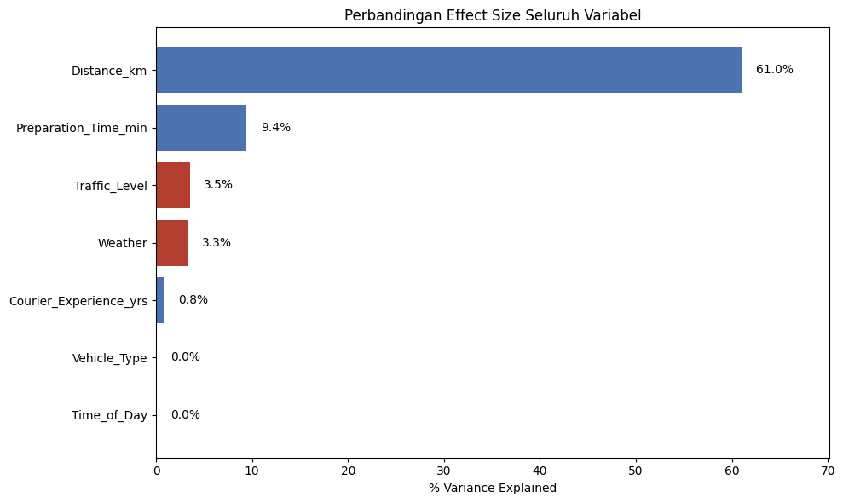

RESULTS
Travel Distance Remains the Dominant Factor
$$r^{2}=0,61$$
The variation in delivery times is explained solely by travel distance.
Weather (0,033) and traffic (0,035) were shown to be statistically significant (p < 0,00001), but their effect size was considerably smaller than that of travel distance.
12

Slide 15
CONCLUSION
Insights & Business Recommendations
1
Adaptive ETA by Onfield Condition
2
Focus on Travel Distance, With Weather and Traffic Conditions as its Main Buffer
Use the historical average table for each traffic and weather combination as the basis for estimates, rather than using one figure for all conditions. The 54% gap between the best and worst conditions is too large to ignore.
Prioritise distance as the primary basis for estimation (61% of variance explained), with weather & traffic conditions as its main buffer (~3% of variance explained); stop optimising based on vehicle type or order time, as neither has been proven to have an effect.
3
Differentiate Time Buffers
4
Make a Record of ETA vs Actual Delivery Time
Consistent buffer for Snowy weather across all traffic conditions; a specific buffer for Rainy weather during high traffic, following the pattern of interaction effects identified.
Begin collecting the ETAs shown to customers to measure the effectiveness of future recommendations and validate their impact on complaints.
13

Slide 16
Thank You

